Slide 1

Digital Transformation and Innovation through Information Systems (IS)
Presented by:
Niraj Adhikari
Raghav Panthi
Srishti Sharma

Slide 2
Introduction
Digital Transformation and Innovation through IS
What is Digital Transformation?
What is Information System (IS)?
An Information System is a combination of:
Digital Transformation is the integration of digital technologies into all areas of an organization.
It changes how businesses operate and deliver value to customers.
It improves efficiency, productivity, and customer experience.
People
Hardware
Software
Data
Networks
Procedures
It helps organizations collect, process, store, and distribute information for decision-making.

Slide 3
Why Digital Transformation?
Traditional Business
Digital Business
Paper-based records
Manual processes
Slow communication
Limited customer reach
Cloud storage
Automation
Online services
Global connectivity
Objectives
Improve efficiency
Reduce costs
Better customer service
Faster decision making
Business innovation

Slide 4


Role of Information Systems in Digital Transformation
Information Systems enable organizations to:
Improve Customer Experience
Automate Business Processes
Payroll
Inventory
Billing
Attendance
Online shopping
Mobile banking
Digital payments
Customer support
Enhance Communication
Improve Decision Making
Email
Video conferencing
ERP ( Enterprise Resource Planning )
CRM(Customer Relationship Management)
Real-time reports
Business intelligence
Data analytics

Slide 5




Emerging Technologies
Artificial Intelligence (AI)
Cloud Computing
Chatbots
Recommendation systems
Image recognition
Fraud detection
Online storage
Software as a Service (SaaS)
Remote collaboration
Scalable infrastructure
Internet of Things (IoT)
Big Data
Smart homes
Smart factories
Smart healthcare
Wearable devices
Large-scale data analysis
Customer insights
Predictive analytics
Better business decisions

Slide 6




Business Impact
Increased Productivity
Cost Reduction
Automation reduces manual work.
Less paperwork
Reduced operational expenses
Better Customer Experience
Competitive Advantage
Personalized services
Faster response
Online support
Faster innovation
Better products
Improved market reach

Slide 7
Societal Impact
Positive Impacts
Challenges
Easy access to information
Online education
Digital healthcare
Mobile banking
Online government services
Digital payments
Job displacement due to automation
Privacy concerns
Cybersecurity threats
Digital divide

Slide 8


Challenges in Digital Transformation
Cybersecurity Risks
High Implementation Cost
Resistance to Change
Hacking
Data breaches
Malware
Software
Infrastructure
Employee training
Employees may hesitate to adopt new systems.
Data Privacy
Skill Gap
Protecting customer information
Compliance with regulations
Need for digital literacy
Continuous learning

Slide 9






Future Trends
Artificial Intelligence Everywhere
Hyper Automation
AI will automate more business operations.
AI and robots work together to automate business processes.
Blockchain
6G Technology
The next generation of mobile networks with faster speeds and lower delay.
A secure system for storing and sharing digital records.
Edge Computing
Green IT
Data is processed closer to device where it is created, reducing delay.
Environment-friendly computing that reduces energy use and electronic waste.

Slide 10
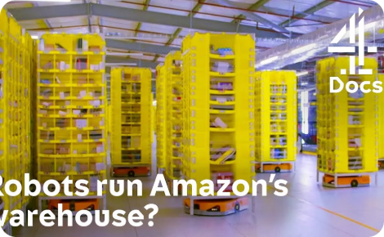
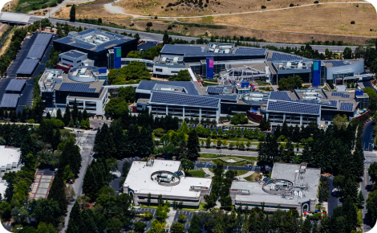
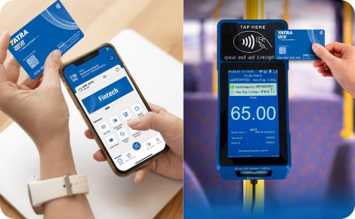
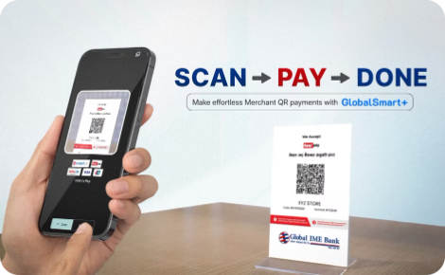
Real-World Examples
Amazon
Google
eSewa
Khalti by IME
AI-based product recommendations
Automated warehouses
Cloud services (AWS)
AI-powered search
Google Cloud
Google Workspace
Digital wallet
Online payments
Utility bill payment
Money transfer
QR payments
Mobile recharge
Ticket booking
Banking integration

Slide 11




Conclusion
1
2
3
Digital Transformation is changing every industry.
Information Systems are the backbone of digital transformation.
AI, Cloud, IoT, and Big Data are driving innovation.
4
5
Organizations must overcome security and implementation challenges.
Businesses adopting digital transformation gain a competitive advantage.
Final Thought
"Digital Transformation is not just about technology—it is about using technology to create better value for businesses and society."

Slide 12







Benefits Summary
Digital Transformation
Automation
Cloud Computing
Benefits
Saves time
Anywhere access
AI
Big Data
IoT
Smart decisions
Better insights
Smart devices
Information Systems
Better management

Slide 13



